Slide 1
Building a Secure Software Development Lifecycle process
By Duncan Matthew Stirling
Notes:
Security is not a black and white field
The black and white mindset is invariably wrong, costly, and ineffective.
Today I am in front of you talking about my perception, and place where I am in regards to helping organizations develop a SSDLC process.
I will run through my slide deck quickly, so we can discuss concepts and questions associated with the product.

Slide 2


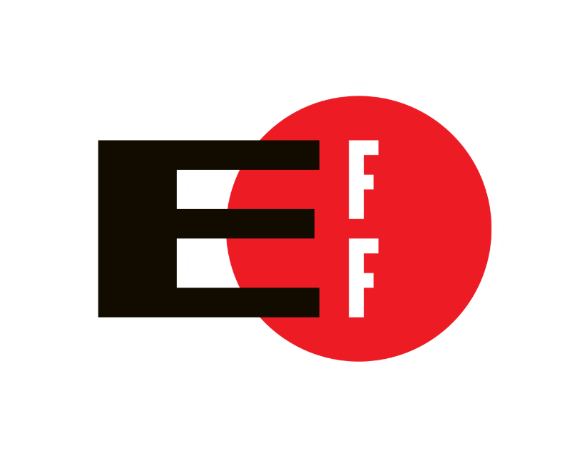
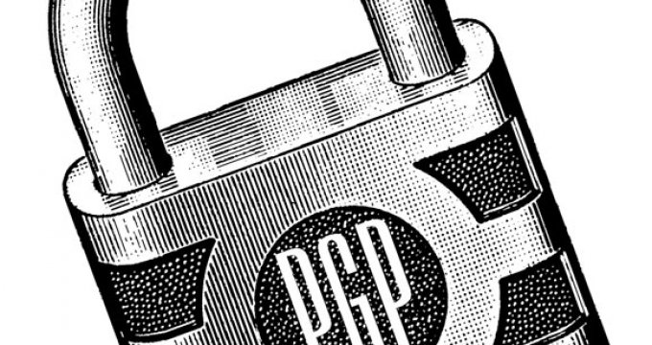

Who am I
I’m a Contractor not a Consultant
All opinions expressed are solely my own

Slide 3
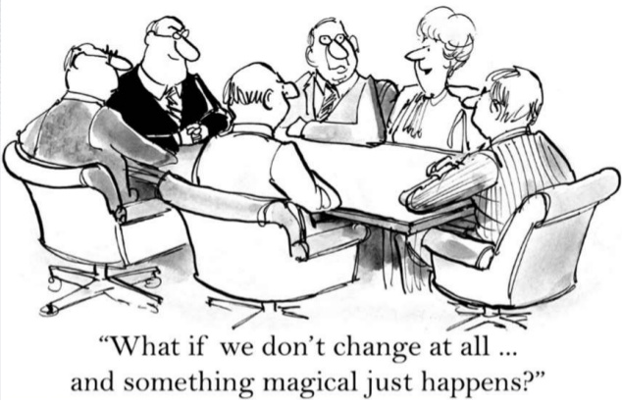
Before I begin

Slide 4
My Spiel
"I was working on improving OpenSSL and submitted numerous bug fixes and added new features. In one of the new features, unfortunately, I missed validating a variable containing a length.“
Robin Seggelmann
Notes:
Heartbleed

Slide 5
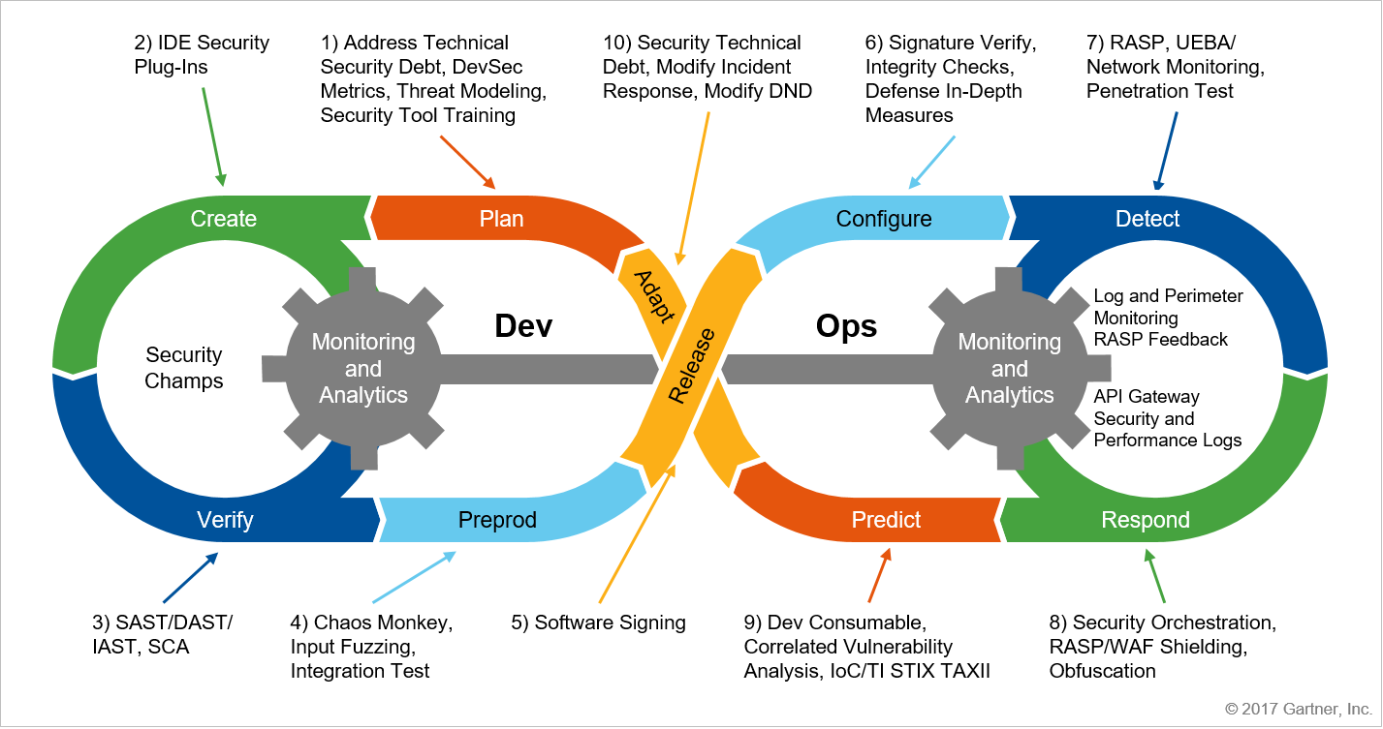
10 keys (that is it)

Slide 6

Key 0 - Training

Slide 7
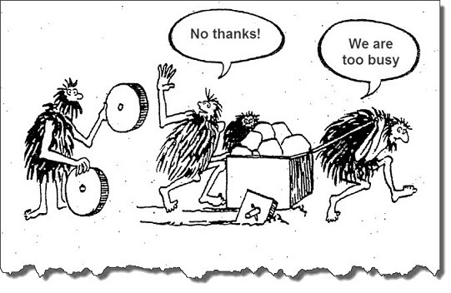
Key 0 - Training

Slide 8
Key 0 - Training
Training enables competency
Doesn’t have to $$$
Open Standards from Open Communities

Slide 9

Key 0 - Training
ASVS
Dev Guide
Code Review Guide
Testing Guide
Secure SDLC Cheat Sheet
Notes:
Dev Guide is

Slide 10
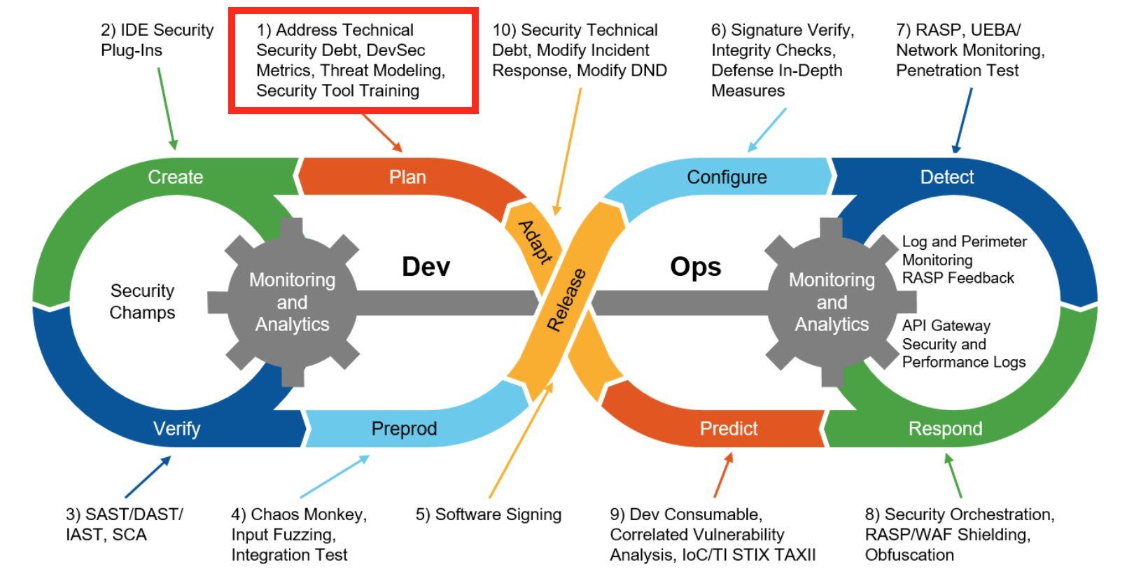
Step 1 - Planning

Slide 11
Step 1 - Planning
Yes, Project Managers Care About Security
When Costs, Delivery, Manageability are considered.

Slide 12
Step 1 - Planning
“The cost of removing an application security vulnerability during the design phase ranges from 30 - 60 times less than if removed during production.”
OWASP, NIST, IBM, and Gartner Group

Slide 13
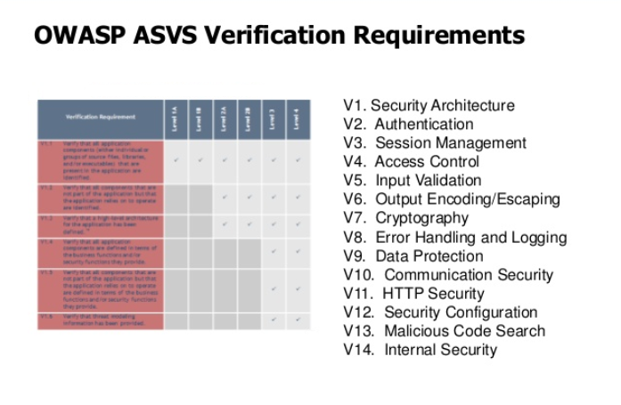
Step 1 - Planning
Institution of a SSDLC process provides a framework for project managers.

Slide 14
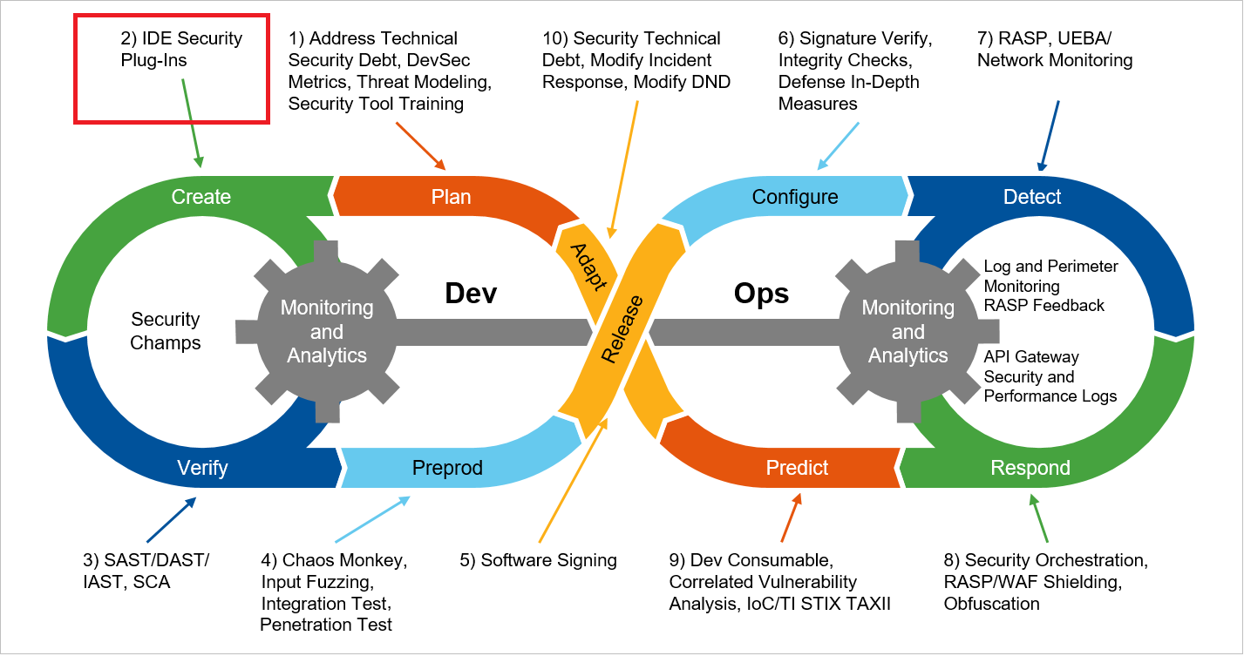
Step 2 - Creation
Notes:
Key concepts
- Developers do care about security, when organizations foster environments where security is invested.

Slide 15
Step 2 - Creation
Yes, Developers Care About Security
A lot of times Developers get thrown under the bus.
Usually there is no formalized AppSec processes in place

Slide 16
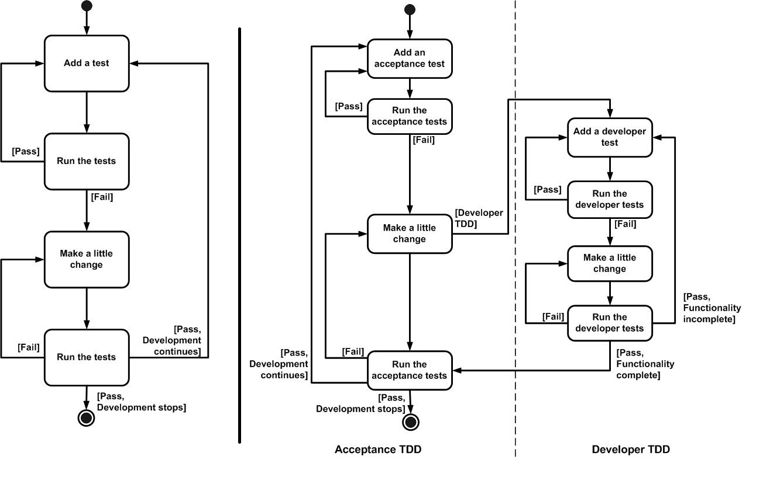
Step 2 - Creation
Notes:
Test Driven Development processes

Slide 17
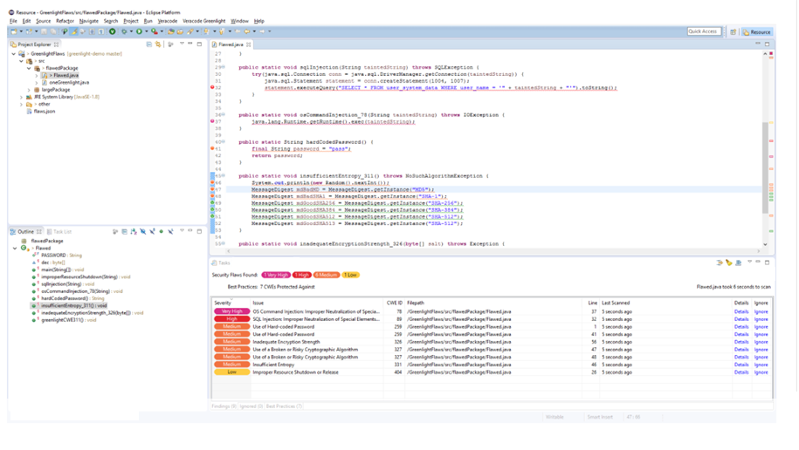
Step 2 - Creation
Notes:
This is a redacted image of a tool I use, I removed the readable gingerly the vendors information.

Slide 18
Step 2 - Creation

Slide 19
Step 2 - Creation
Think Like an Attacker
Challenge assumptions about the trustworthiness of inputs

Slide 20
Step 2 - Creation
Bring Greater Discipline to Component Use
ReThink software component security
Notes:
This is a redacted image of a tool I use, I removed the readable gingerly the vendors information.

Slide 21
Step 2 - Creation
Institution of a framework for Development teams & managers.

Slide 22
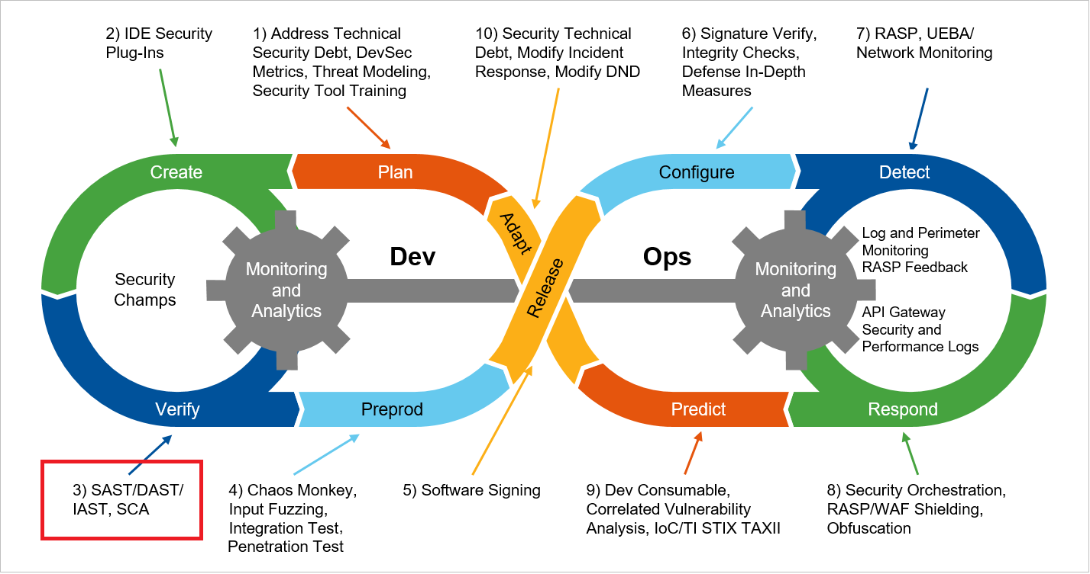
Step 3 - Verification

Slide 23
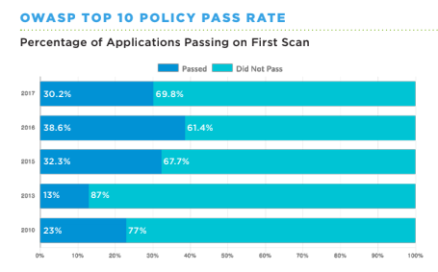
Step 3 - Verification
Notes:
Most organizations have little idea of the security of their code on first pass.

Slide 24
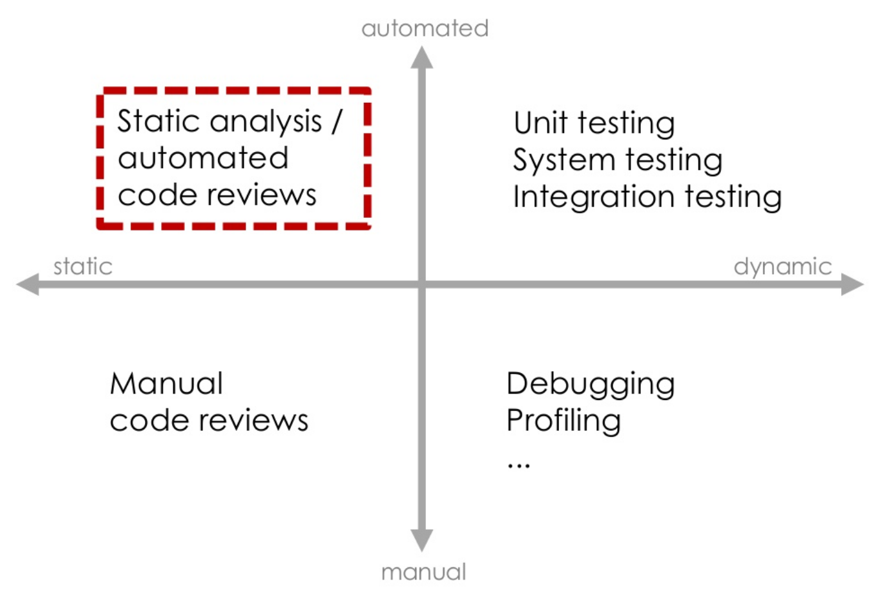
Step 3 - Verification
PyCon 2015 Montreal - Andreas Dewes (@japh44)

Slide 25
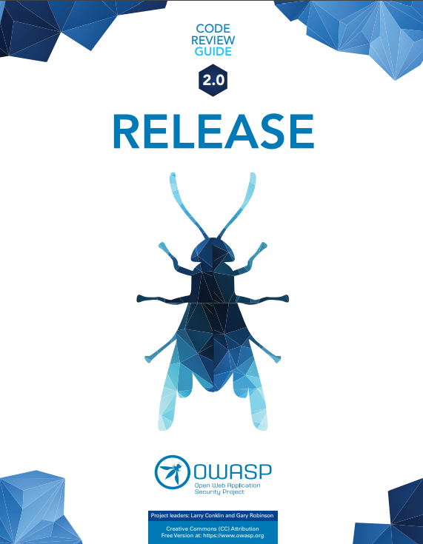
Step 3 - Verification
Notes:
Most organizations have little idea of the security of their code on first pass.

Slide 26
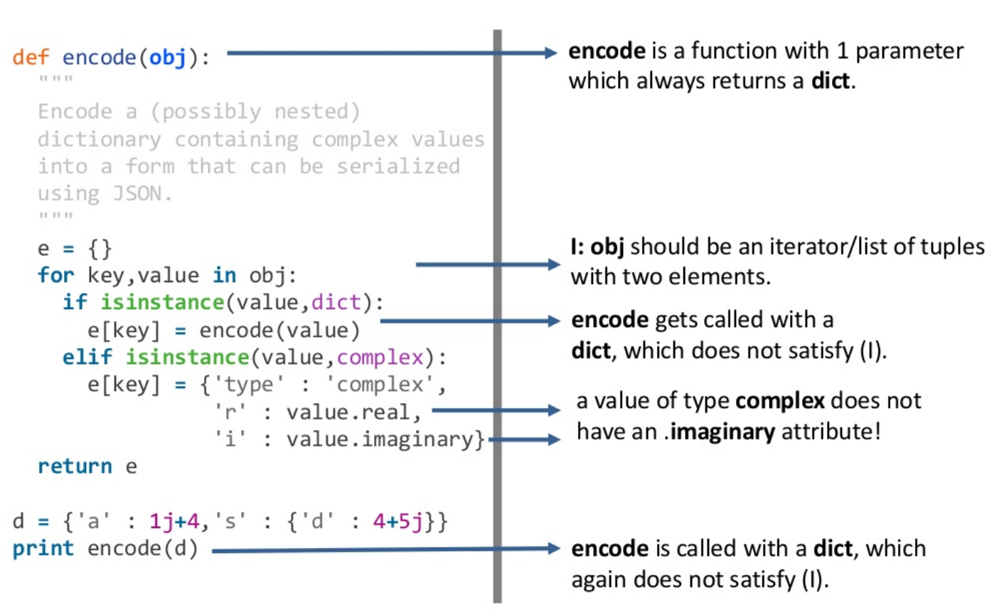
Step 3 - Verification
PyCon 2015 Montreal - Andreas Dewes (@japh44)

Slide 27

Step 3 - Verification
Control has a template
Notes:
Most organizations have little idea of the security of their code on first pass.

Slide 28
Step 3 - Verification

Slide 29
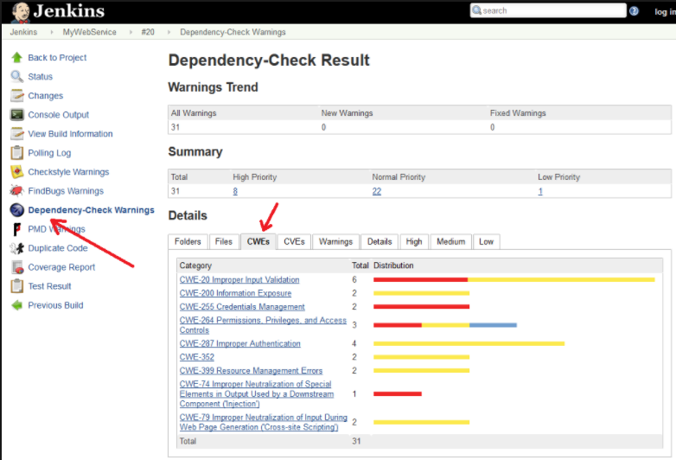
Step 3 - Verification

Slide 30
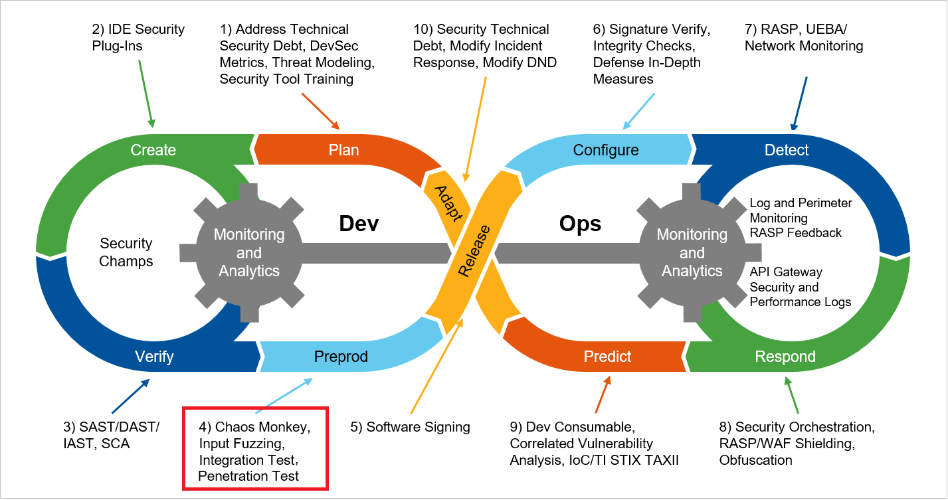
Step 4 - Preprod Simulation Testing

Slide 31
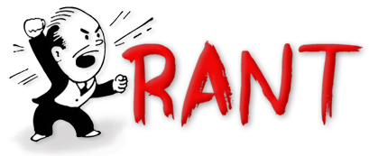
Step 4 - Preprod Simulation Testing
Segregated environments

Slide 32

Step 4 - Preprod Simulation Testing

Slide 33
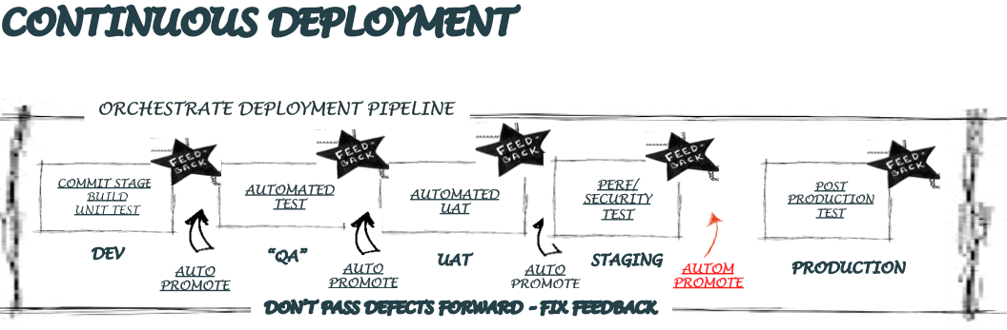
Step 4 - Preprod Simulation Testing

Slide 34
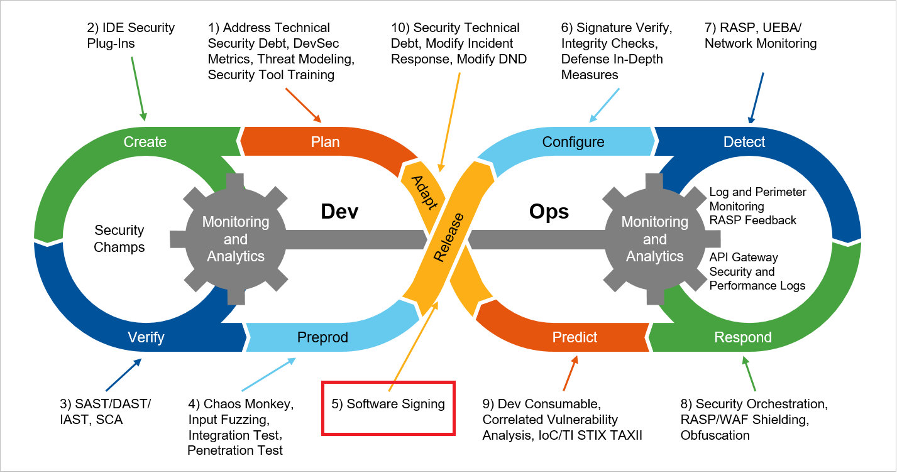
Step 5 - Release

Slide 35
Step 5 - Release
Production Deployment
Post-production activities
Maintenance & Support
obtaining feedback from end-users

Slide 36

Step 5 - Release

Slide 37
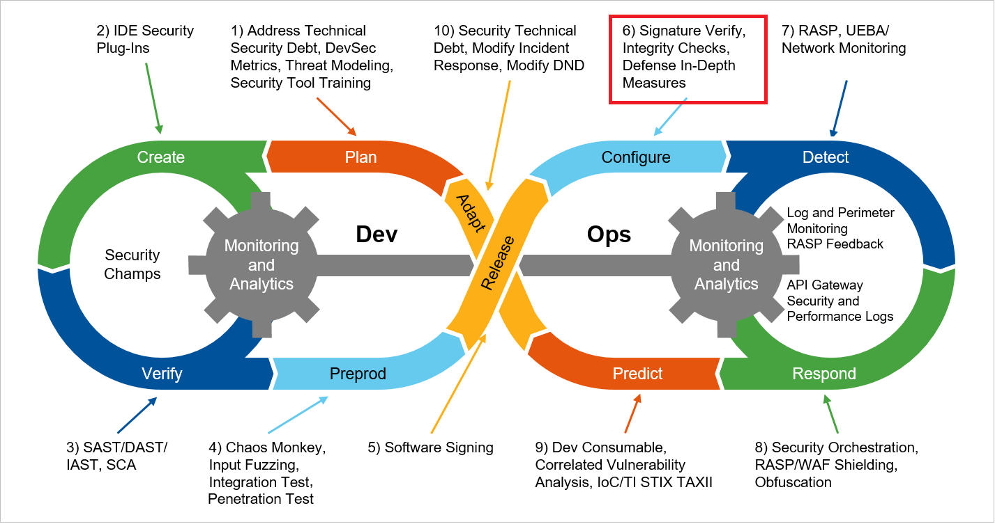
Step 6 - Configuration

Slide 38

Step 6 - Configuration

Slide 39
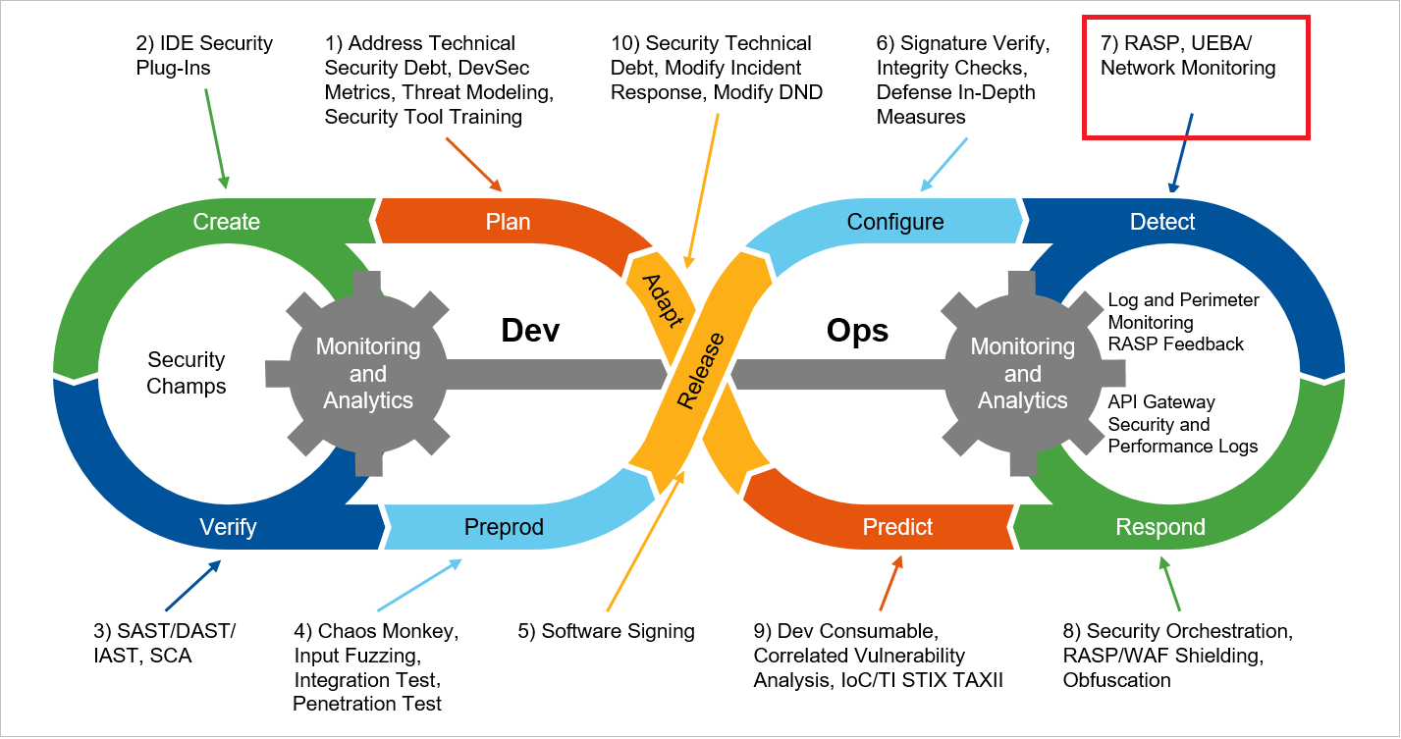
Step 7 - Detection

Slide 40

Step 7 - Detection

Slide 41
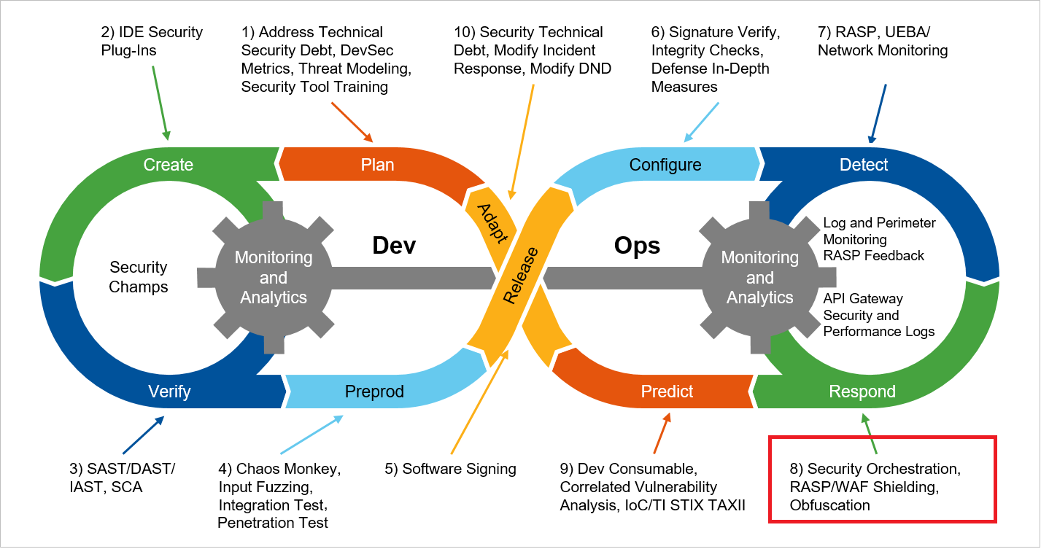
Step 8 - Respond

Slide 42
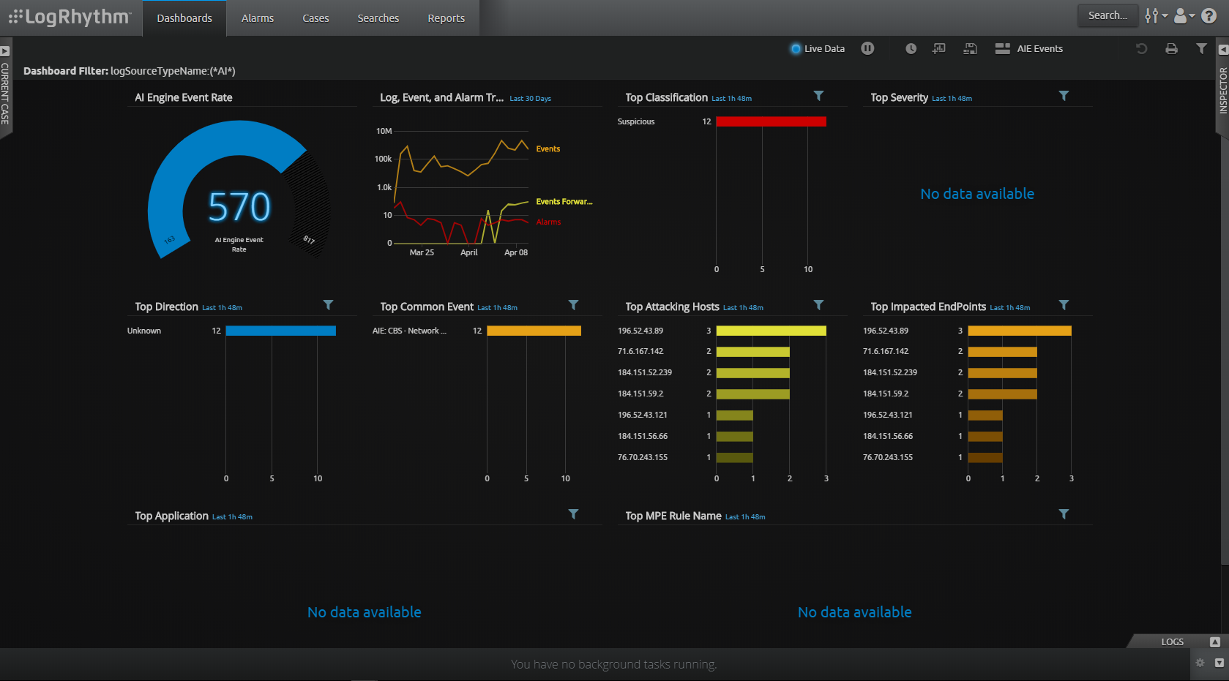
Step 8 - Respond

Slide 43
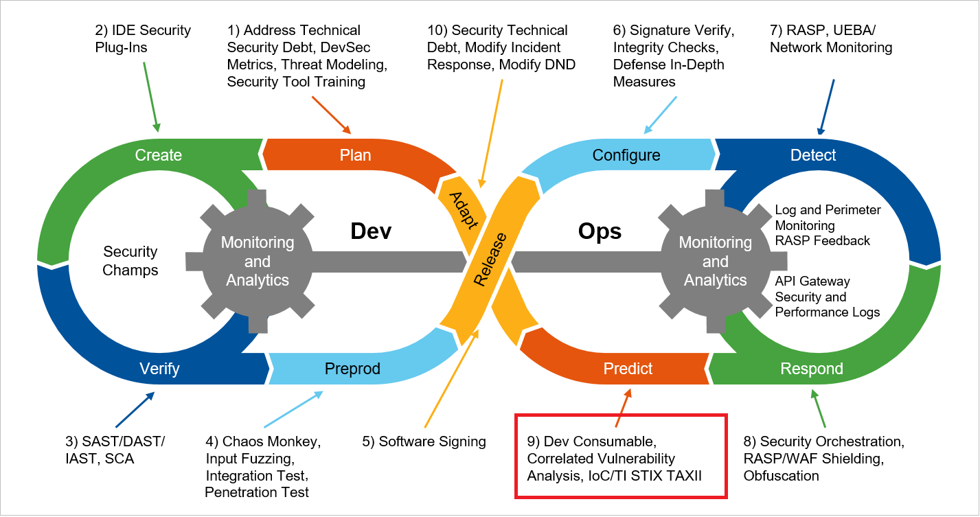
Step 9 - Predict

Slide 44

Step 9 - Predict

Slide 45
Step 9 - Predict

Slide 46
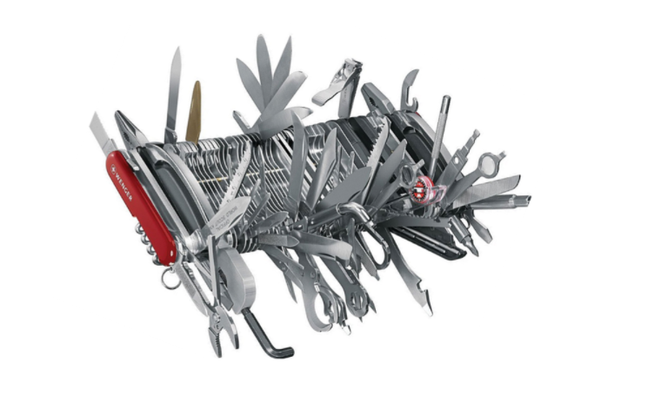
Step 9 - Predict

Slide 47
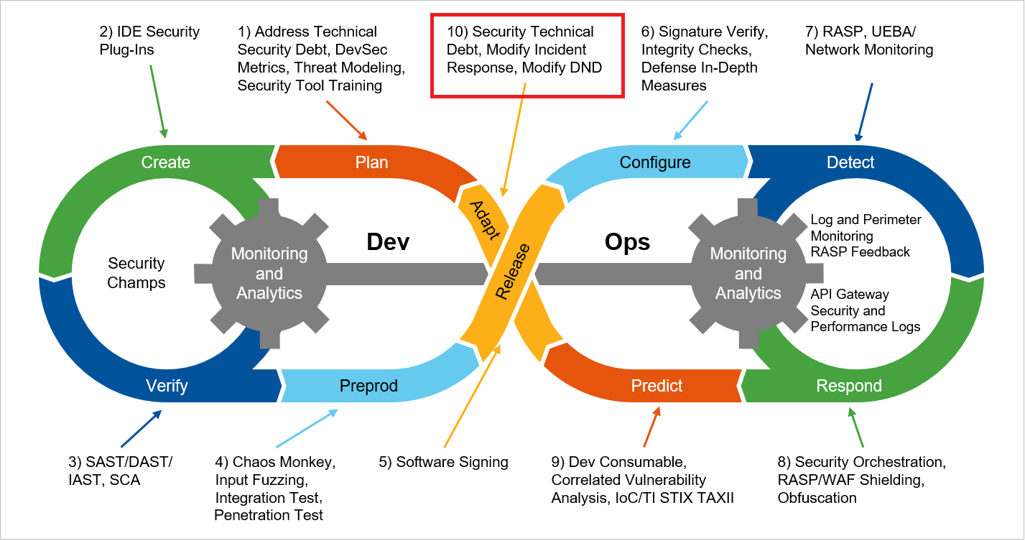
Step 10 - Adapt

Slide 48
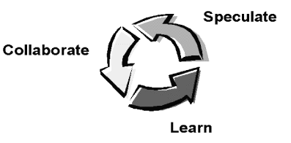
Step 10 - Adapt

Slide 49
Step 10 - Adapt
{ Q }

Slide 50
Conclusion
AppSec Depends on You
duncan@redactedsecurity.ca
@stumblesthedrunk
Notes:
We need to become the full spectrum engineers (FSE), someone who is not just good at keeping up with the latest trends in design and implementation, but knows how to test for quality, performance, and security.

